Slide 1
ARCI PCD Execution SIA
OETRAX 324116
PCD Tracking Requirements
February 2, 2017

Slide 2
Action
Create requirements document and review with Karen Ferraro and the team.
Owner: Eubank
Target: January 30, 2017

Slide 3
PCD Next
Authorize Work
Authorize work in accordance with Contract SLINs or FEAs
Initial ARCI Production Work Authorization Directives (WADs)
ARCI Engineering Services in accordance with Technical Instructions
Satisfy ARCI Production PPMP requirements for initial WADs
Purchase Materials to Support Production or Development
PM direction to purchase materials
Attach quotes or other documents to support purchases
Provide labor and material work packages
Describe what needs to be done, by whom and when
Integrate PCD Tracking
Initial identification of requirements
Ensure pre-requisites are satisfied (e.g. PLs, Part Numbers, BOMs)
Provide data and reports to support weekly review of progress
Manage process from initial identification of requirements to PR issue
Other Program Communications
Delegations of Authority
Significant information of interest to program-wide distribution

Slide 4
Requirements
The PCD tool is over 16 years old
Update to new standards and best practices
Update user interface
Retain all current PCD functionality
PCD is used by multiple organizations
PCD is used by multiple programs
Avoid changes that will reduce current users’ ability to use the tool
Add new functionality to satisfy ARCI needs that any program may opt to use or not without additional modifications
Maintains PCD as an Enterprise Business tool
May reduce cost of updates to ARCI Program
Double click to open embedded PCD “Next” requirements

Slide 5
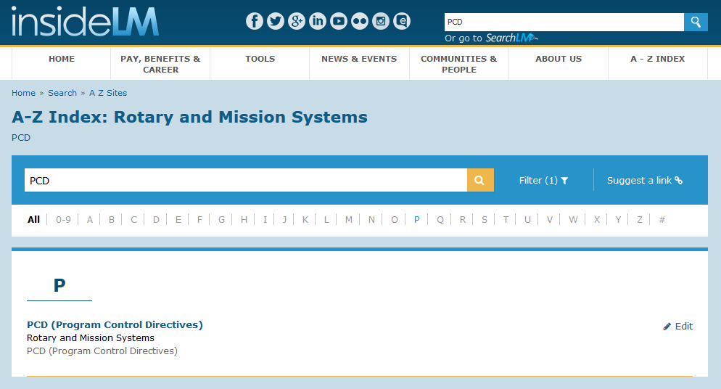
PCD Tool Access

Slide 6
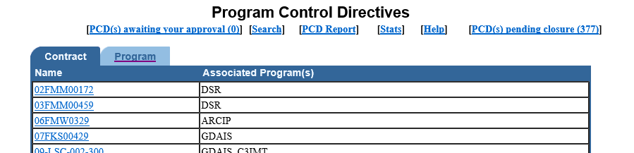
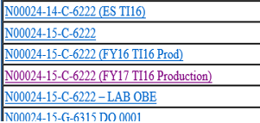
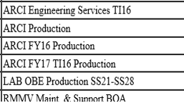
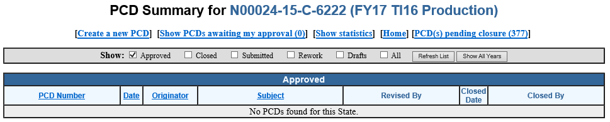
New PCD Tracking Module
Consolidate Existing TI16 ARCI Production Programs under “ARCI Production”
New Button
PCD Tracking
ARCI Production

Slide 7

Search
PCD Tracking for
ARCI Production
Search Options
RecID
Keyword(s)
PCD
TBD
Contract
N00024-15-C-6222
Mod
SLIN
Funded
Y
FEA
PN
Dwg
BOM
Man PR
Clw PR
N
Customer RDD
1/1/17
to
12/31/19
PCD Required
to
Internal RDD
to
Next Review
to
Program Defined
Hull
SSN 794
TI
TI16
Search
Edit Search
Clear Search

Slide 8

Search Results
PCD Tracking for
ARCI Production
Search Options
RecID | Hull | TI | Item | PCD | Customer RDD | Internal RDD | PCD Required | Next Review | Funded | FEA | PN | BOM | MAN PR | CLW PR | Contract | Mod | SLIN
00144 | 794 | TI16 | Early Fiber Delivery | 15-ARCI FY15 Production-LMDM-PCD00002C | 7/3/2017 | 7/3/2016 | 3/3/2016 | Complete | Y | N | Released | Released | Y | Y | N00024-15-C-6222 | PZ0001 | 0010AC
00147 | 794 | TI16 | LWWAA | 15-ARCI FY15 Production-LMDM-PCD00002C | 1/11/2019 | 1/11/2018 | 3/3/2016 | Complete | Y | N | Released | Released | Y | Y | N00024-15-C-6222 | PZ0001 | 0010AC
00146 | 794 | TI16 | System | 15-ARCI FY15 Production-LMDM-PCD00002C | 12/11/2017 | 12/11/2016 | 3/3/2016 | Complete | Y | N | Released | Released | Y | Y | N00024-15-C-6222 | PZ0001 | 0010AC
00999 | 794 | TI16 | TI16 NewCon ODC Spares | TBD | 1/1/2019 | 1/1/2018 | 2/1/2017 | 2/16/2017 | N | N | Released | Pre-Rel | N | N | N00024-15-C-6222 | PZ0001 | 0203AD
00865 | 794 | TI16 | TI16 NewCon Spares (OBRP) | TBD | 1/1/2019 | 1/1/2018 | 2/1/2017 | 2/16/2017 | N | N | Released | Pre-Rel | N | N | N00024-15-C-6222 | P00012 | 0010AE
Edit Search
Select

Slide 9
PCD Tracking Data Entry/Review
PCD Tracking for
ARCI Production
RecID
00999
Subject
VA Class (New Con) Delta Spares
PCD
TBD
Contract
N00024-15-C-6222
Mod
SLIN
$ Est
Funded
N
P00012
0203AD
$300K
FEA
PN
Dwg
BOM
Next Review
N
Released
Released
Pre-Rel
3/2/17
Customer RDD
1/1/19
Internal RDD
2/1/18
PCD Required
2/1/17
Process1
Role1
Role2
Role3
Add…
Delete
Add…
Delete
Add…
Delete
BOM
Originator
Name
Reviewer
Name
Approver
Name
Process2
Role1
Role2
Role3
Add…
Delete
Add…
Delete
Add…
Delete
PCD
Originator
Name
Reviewer
Name
Approver
Name
Program Defined Fields
Hull
SSN 794
MAN PR
N
TI
TI16
CLW PR
N
Notes
Create New RecID
Copy to New RecID
Edit
Save
Delete
Draft PCD

Slide 10
Workflow
Engineering Release
Role A
Originator
Engineering
Role B
Reviewer
Engineering
Role C
Approver
Program Management
Capability to approve or reject workflow
Confirms completion of workflow
Creates PN/Dwg/BOM

Slide 11
Workflow
Issue PCD
Role A
Originator
Program Management
Role B
Reviewer
PC
Role C
Approver
Program Management
Capability to approve or reject workflow
Confirms completion of workflow
Submits PCD Draft

Slide 12
Workflow
Create Purchase Requisition
Role A
Originator
Operations
Role B
Reviewer
Operations
Role C
Approver
Operations
Capability to approve or reject workflow
Confirms completion of workflow
Create PR

Slide 13
Reports
Pre-Defined
PCD similar to current View/Printable Version
PCD Tracking Export to MS Excel
Ad Hoc Reports (Examples)
PCDs by Work Package
PCDs by Contract
PCD Distribution by Contract

Slide 14
Backup

Slide 15
A-RCI PCD Execution SIA OETRAX 324116
Problem Statement:
The PCD tool is not integrated with other ARCI processes and there are no plans or funding at the Enterprise level to improve or update it. Actual placement of materials purchase orders after issuance of a PCD takes too long in many cases. Timelines and RIs are inconsistent from order to order.
The ordering process (who, what and when) must be improved to realize overall reduction of the time between PCD and placement of purchase orders.
The PCD tool must be replaced by “PCD Next” to meet future ARCI Program needs.
SIA Dates: January 9, 2017
Champion: J. Fanto
Sponsor: J. Eubank
Objectives / Deliverables:
Implement an efficient standardized process to get authorized ARCI materials on order quickly
Reduce process time between PCD and placement of purchase orders
Replace PCD with an updated tool/toolset that is compatible with or can be integrated with downstream ARCI processes.
Improve efficiency by reducing administrative/management labor to issue/update program direction
Team Leaders: J. Eubank and Katie Baldwin
OE Facilitator:
Stacy Cone (GB)
Gerry Ulrich (BB)
SIA Scope Information:
Process Start: When program direction must be communicated to the ARCI team
Process End: When program direction is received by all RIs, and PRs are launched POs are placed.
Preliminary Requirements:
PCD Next must be easy to use and reduce errors/rework inherent in manual data entry
PCD Next must satisfy minimum requirements for initial WADs per EVM guidelines
Historical records in current PCD system must be searchable and retrievable for copy/modify and update by PCD Next
PCD Next must facilitate RI(s) acknowledgment of PCD receipt, progress reporting, and completion of actions required/closure
Team Members:
Bill Jones, ARCI PMT
Randy Charlsen, ARCI MPM
Jeremiyah Mullins, PC
Paul Yerkes, QA
Bob Benson, Documentation
Karen Ferraro, Enterprise Business Services
April Galbraith, Purchasing
On-call subject matter experts

Slide 16
A-RCI PCD Execution SIA
Problem/Opportunity...
Non production PCDs ordering material are at risk of being lost and missing Customer need dates. Process and supporting tool needed to be updated to eliminate the risk of missing Customer needs.
Focused on production material funded out of Engineering Services
The analysis/changes...
Current State
Identified information needed
Identified vulnerabilities in the current state for missing requirements and losing track
Future State Process & Rhythm
Results/Benefits…
Future state brings data into a single tool and minimizes the risk of overlooking important milestones.
Identified a tool that meets the needs of the Program Office.
Team Members:
Joey Eubank, Bill Jones, Katie Baldwin, Joe Fanto,
Randy Charlsen, Jeremiyah Mullins, Paul Yerkes, Bob Benson, Karen Ferraro, April Galbraith, Purchasing
Consolidated multiple data sources and tools into one new consolidated tool.
Resulting standardization and rhythm helps ensure that no customer need is missed!

Slide 17
Future State

Slide 18
What Gets Captured in the Tool:
Existing PCD fields +
Customer required delivery date
Wake up date/funding needed by date
Description of deliverable
Estimate for ODC funded production material
Contract No
PCD
Contract Mod Number
SLIN
TI
Hull No.
"Other"
Program Name/Variant
RS ID No. (Cannot be changed)
BOM Status
Funding Source

Slide 19
Requirements
Divorced from COS/SAP
Export capability to Xcell
Workflow capability
Retain historical information from currrent system (import capability)
Pre-define reports / customizable reports
Not available externally
No access outside continental U.S.
Accessible to subcontractors with NTIDs
Manual work flow routing
Ability to delegate

Slide 20
Considerations
Determine if there is data that can be pulled on contracts from ECE or ??
How does update/change happen? Need history when changes are made.

Slide 21
Weekly Status Meeting Outline
Key People
Agenda of what needs to be reviewed
Key People:
MPMs: Randy Charlsen and John Lane
Program Office: Joey Eubank, Bill Jones, Steve Zajkowski, Jeremiyah Mullins
Review:
Each RS listing

Slide 22
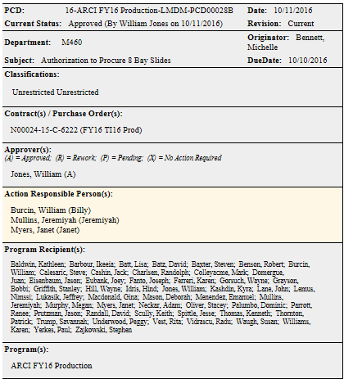
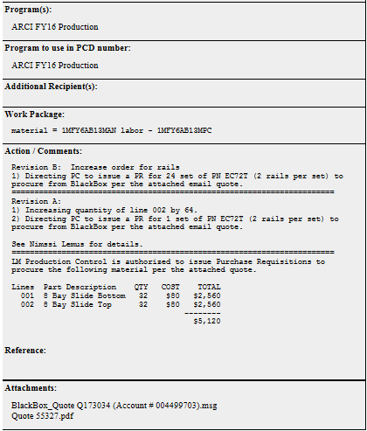
PCD Example

